Slide 1
How plasma proteomics will help your drug repositioning and vaccine development programs for COVID-19

Slide 2
Proteomic Screen for COVID-19 needs
What we know.
To date, the cellular mechanisms underlying the immune response and disease severity of COVID-19 are still poorly understood
A comprehensive overview of the inflammation processes of COVID-19 is still lacking
There are significant variance in disease severity of COVID-19 with many unknowns on why some people are facing severe outcomes
Multiple organ systems are impacted by the disease causing short- and long-term effects
What we need.
Broaden our understanding of the pathophysiology behind COVID-19 with deep profiling of the inflammatory system
Predictors of disease severity and ways to stratify patients in the context of outcomes
Biomarkers correlative to viral load or subsequent viremia
Understanding of therapeutic impacts on multiple organ systems and inflammatory biomarkers
Identification of new therapeutic targets and methods to evaluate drug repositioning to treat COVID-19 patients

Slide 3
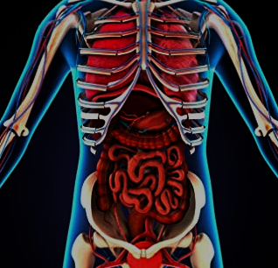
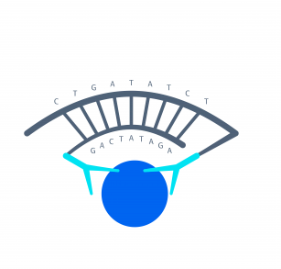
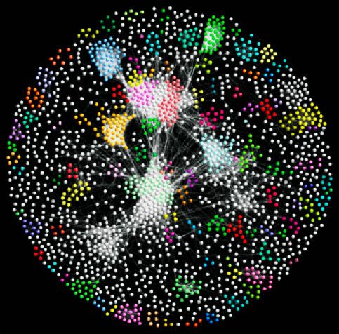
How We Can Help
Proteomic Screen for COVID-19 needs
Olink Explore provides a validated multi-organ system monitoring tool revealing insights into COVID-19
Protein biomarkers associated with COVID-19 impacted organs
Broad coverage of high-sensitivity inflammatory protein assays
Our service provides insights into COVID-19 and therapeutic impacts across the body using just a few μl of blood

Slide 4
Understanding COVID-19 by Olink Some examples from published papers
Proteomic Screen for COVID-19 needs
Biological Pathways/ Mechanisms | Olink Protein Biomarker Changes in COVID-19 patients | Hypothesis/Outcomes
IL6/IL1 Inflammatory pathway | IL6 upregulation in Intensive Care Unit (ICU) patients | Homogenous endotype in severe disease (ICU patients) Tocilizumab (anti-IL6 rec) and Anakinra (IL-1 receptor antagonist) are potential treatment options ¹
Fibrosis | HGF, FGF21 upregulated in ICU patients | Long term fibrosis contributors¹
Kinin-kallikrein system | DPP4, PCI/Serpina 5 downregulated in ICU patients | Disruption of coagulation¹
Proinflammatory mediation | ENRANGE, TNFSF14, increase in severely ill patients | Lung inflammation, fibrosis, remodeling; ENRANGE, TNSFS14 or their receptors potential drug targets ²
Inflammation, angiogenesis, Th1 immune response | IL-17A, IL6, CXL10, TWEAK, ADA | Multisystem Inflammatory Syndrome in Cov-2 infected children (MIS-C) differs from Kawasaki disease in the underlying immunopathology ³
^{1:} Frank L. van de Veerdonk, PhD, Nico A.F. Janssen, MD, Inge Grondman, MD. et al.A systems approach to inflammation identifies therapeutic targets in SARS-CoV-2 infection (2020) medRxiv preprint doi: https://doi.org/10.1101/2020.05.23.20110916 medRxiv preprint
²: Arunachalam P, Wimmers F, Mok C, et. al. Systems biological assessment of immunity to mild versus severe COVID-19 infection in humans. (2020) Science, DOI: 10.1126/science.abc6261
³: Consiglio CR, Cotugno N, Sardh F, et. al. The Immunology of Multisystem Inflammatory Syndrome in Children with COVID-19 (2020) Cell, 10.1016/j.cell.2020.09.016.

Slide 5
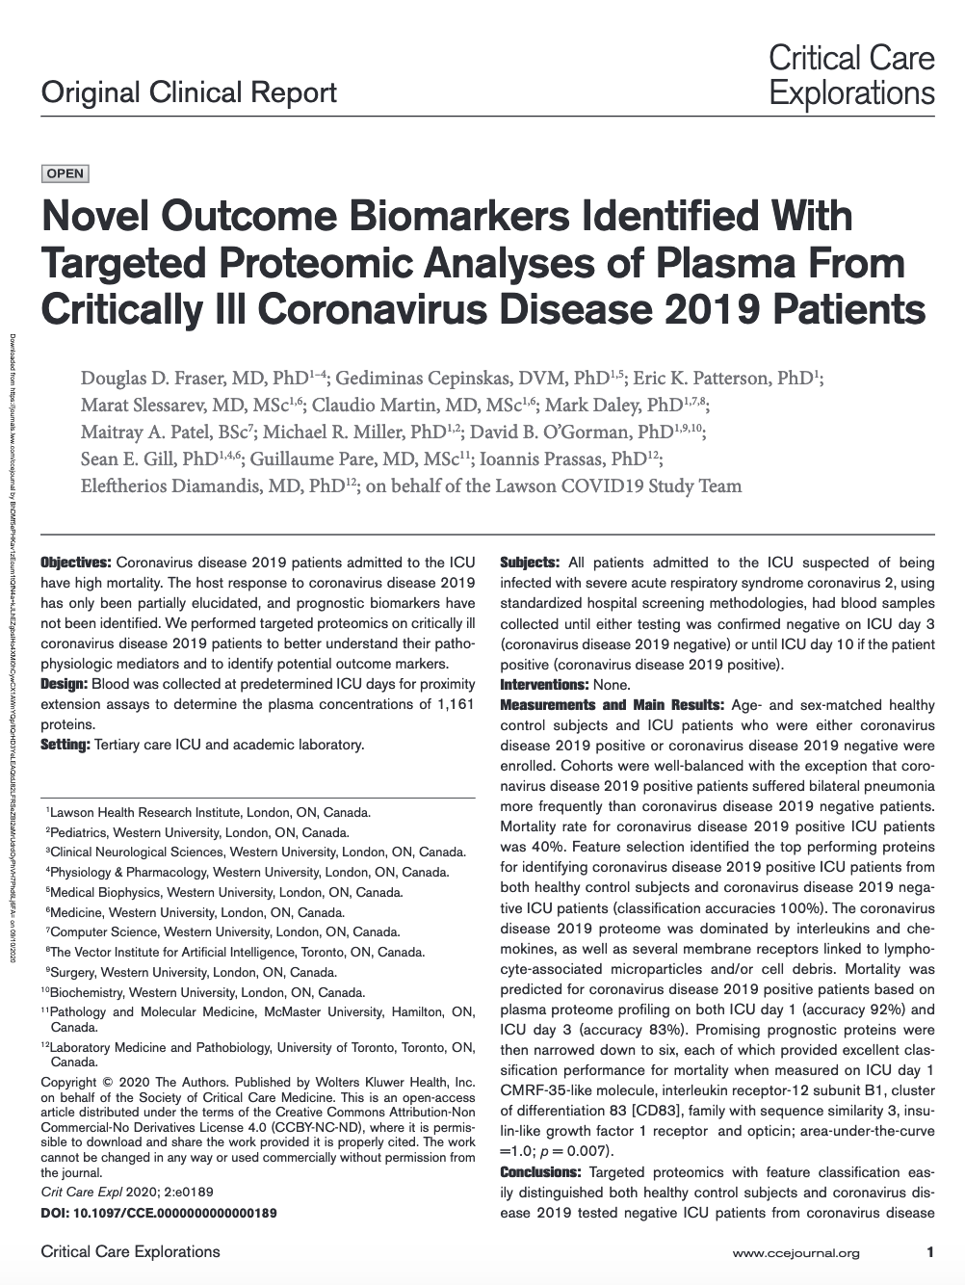
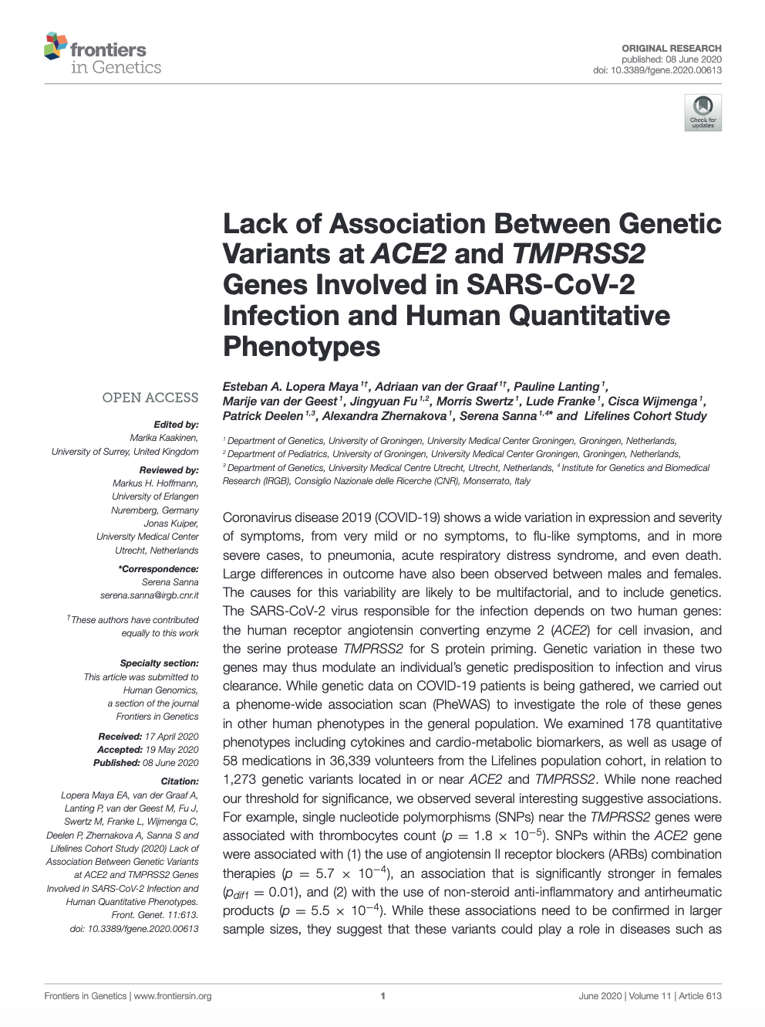
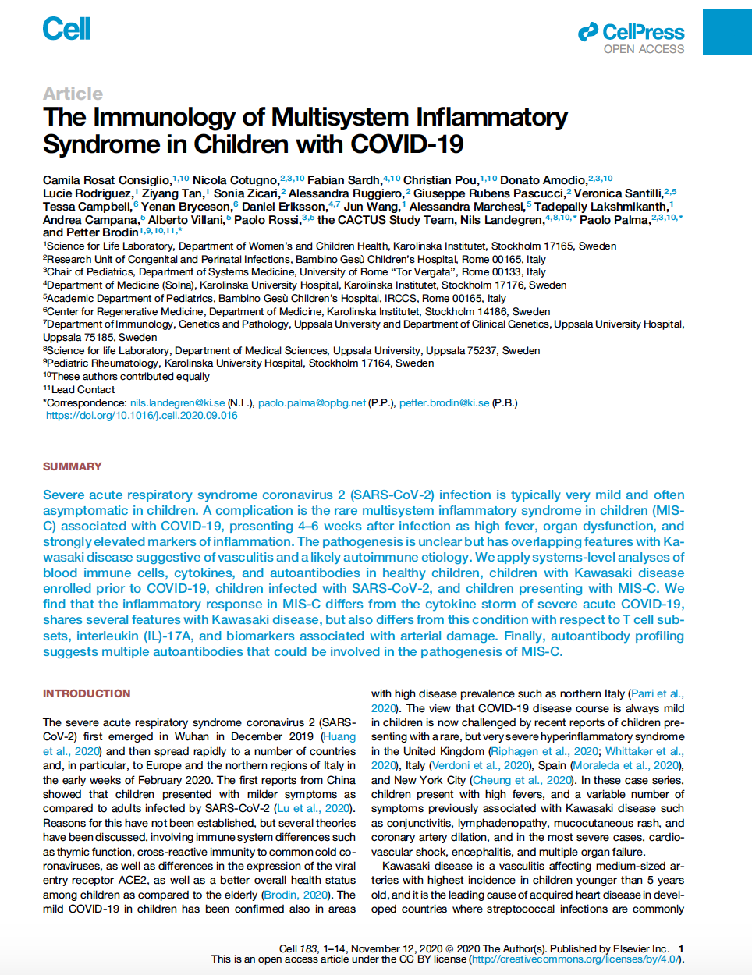
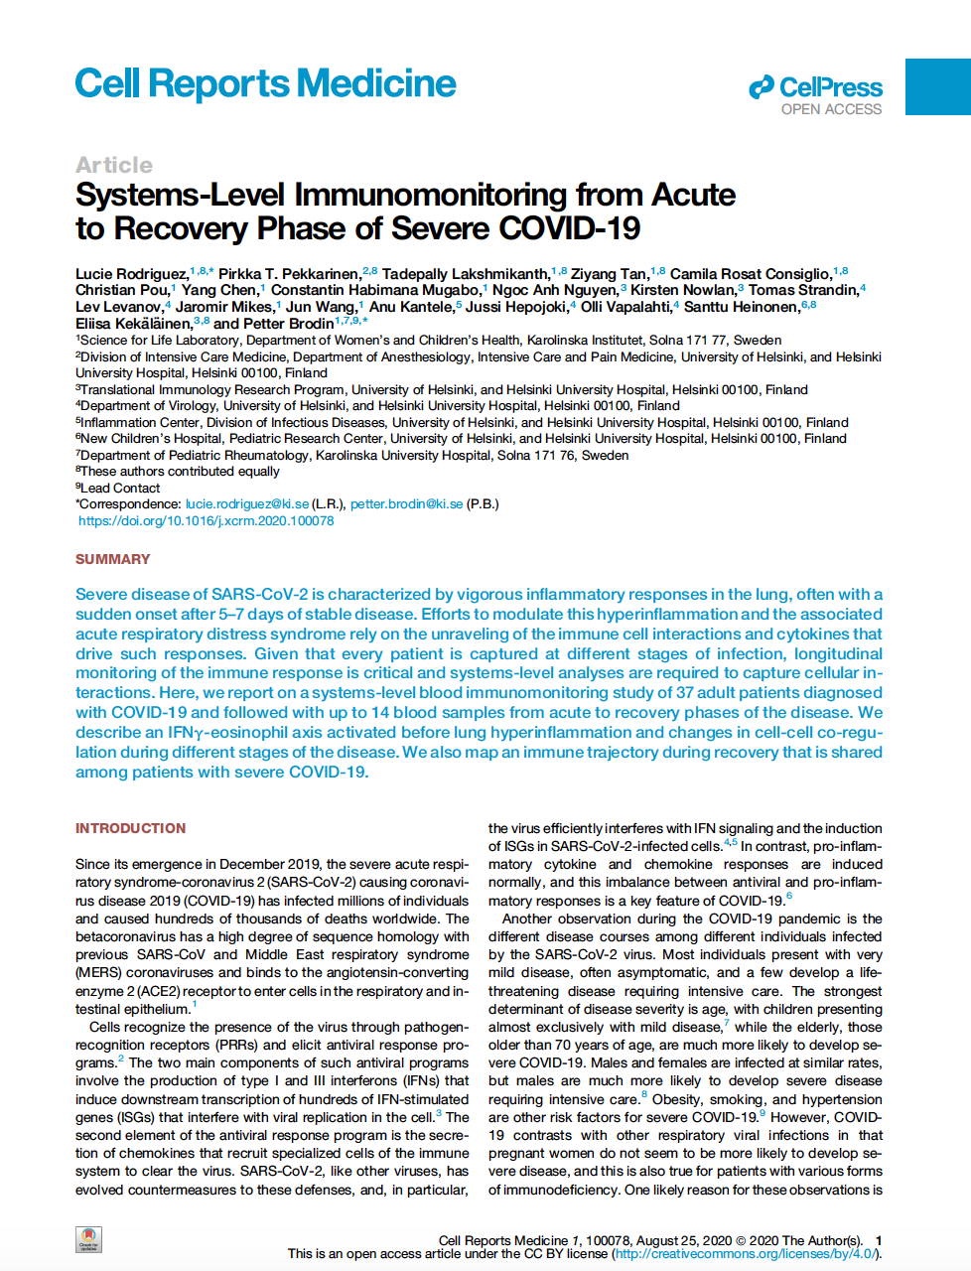
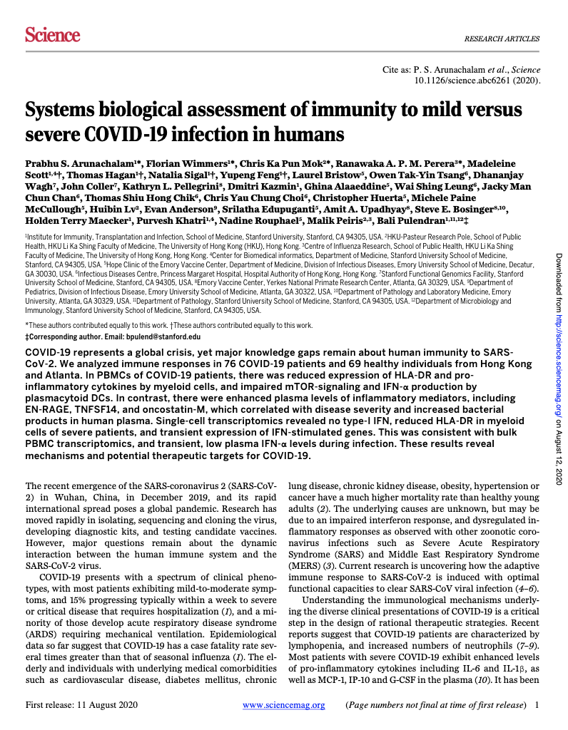
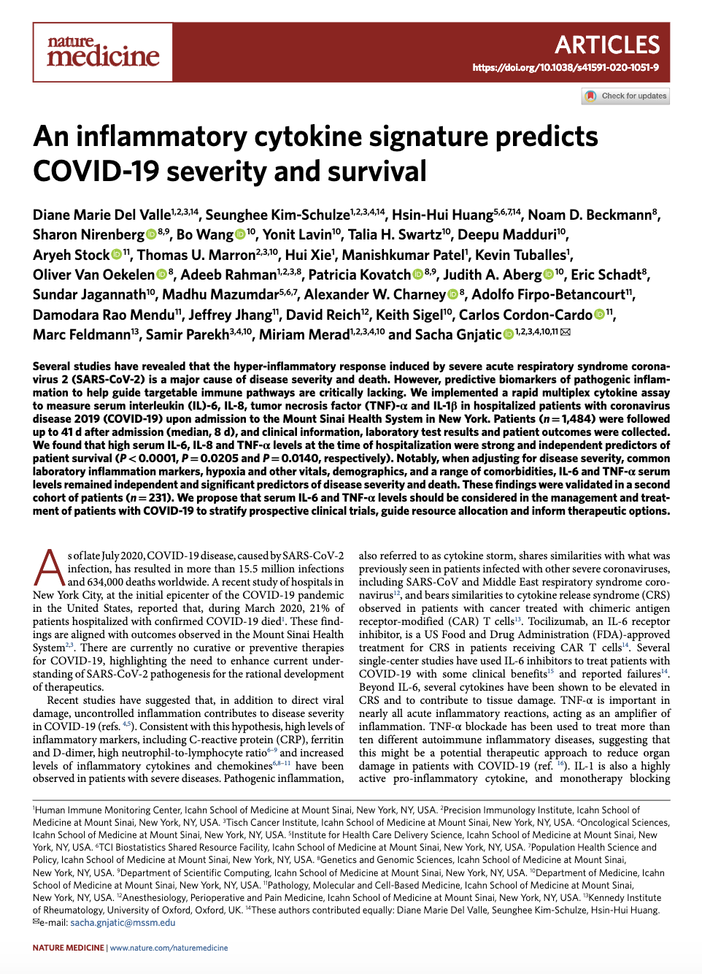
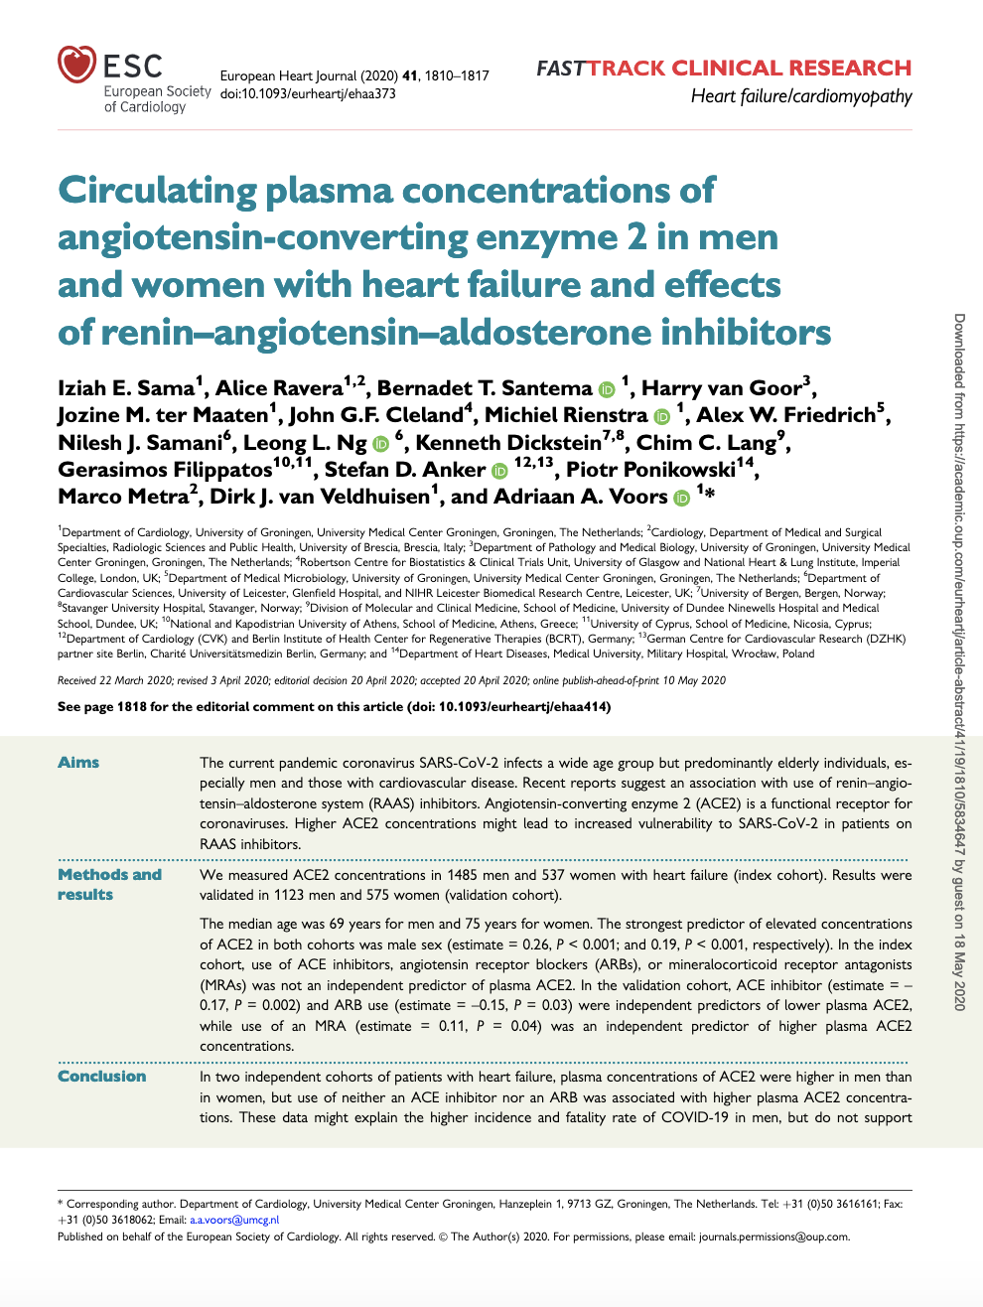
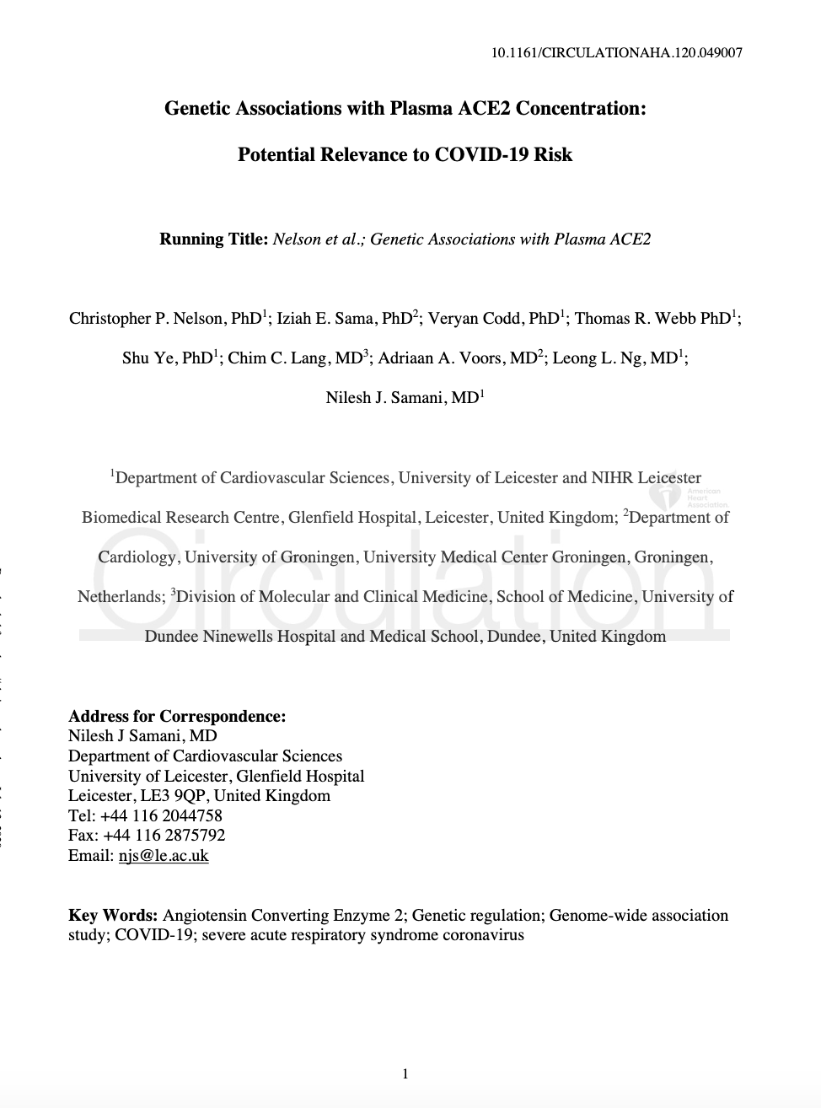
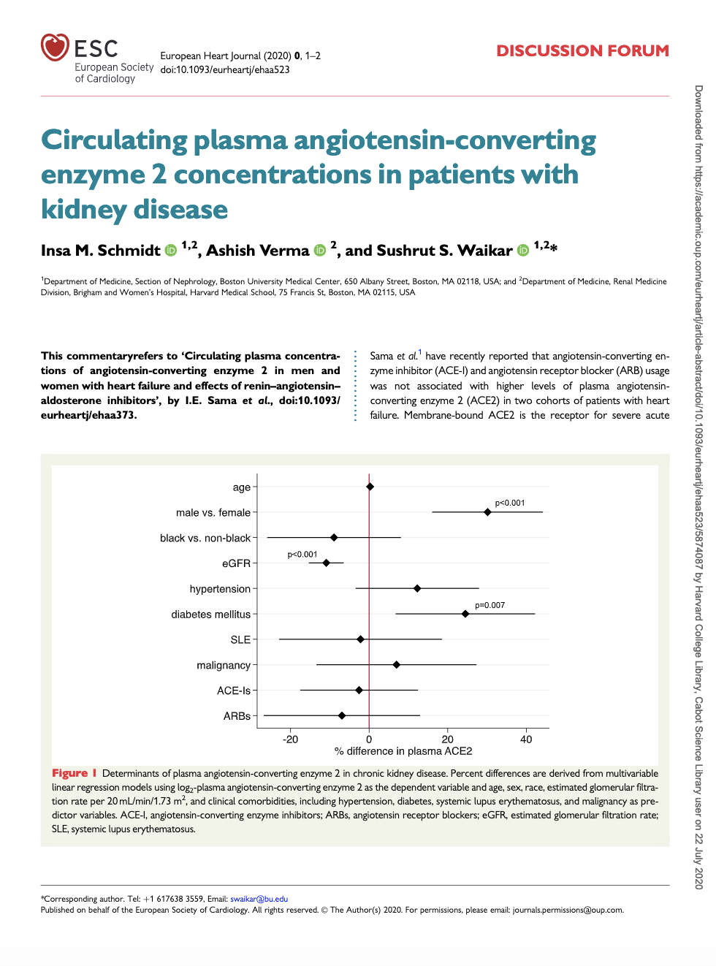
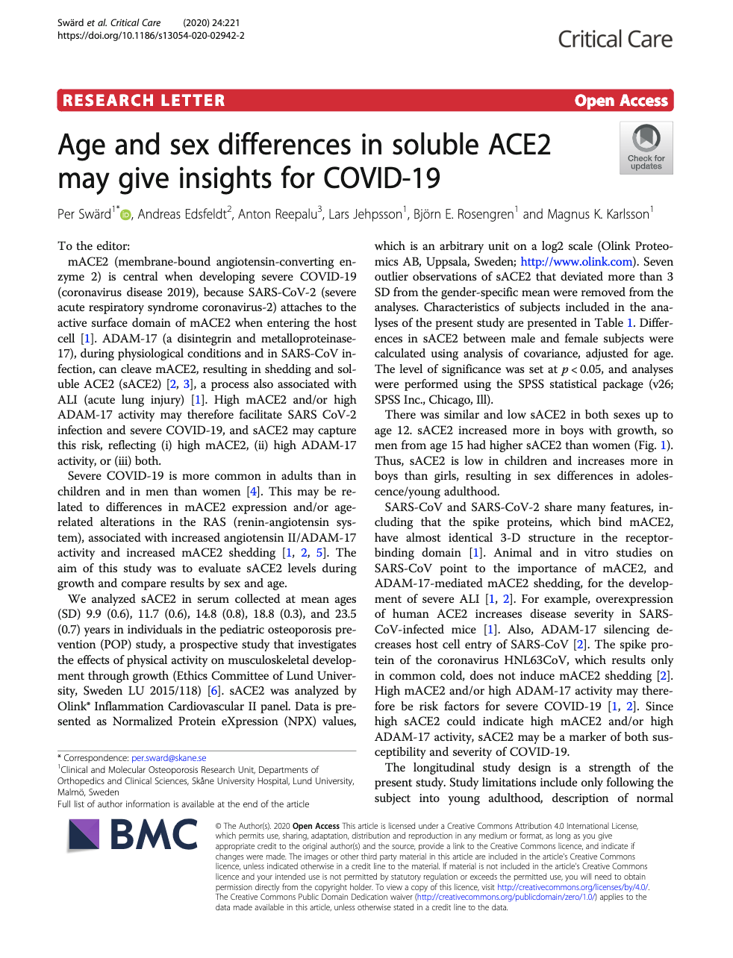
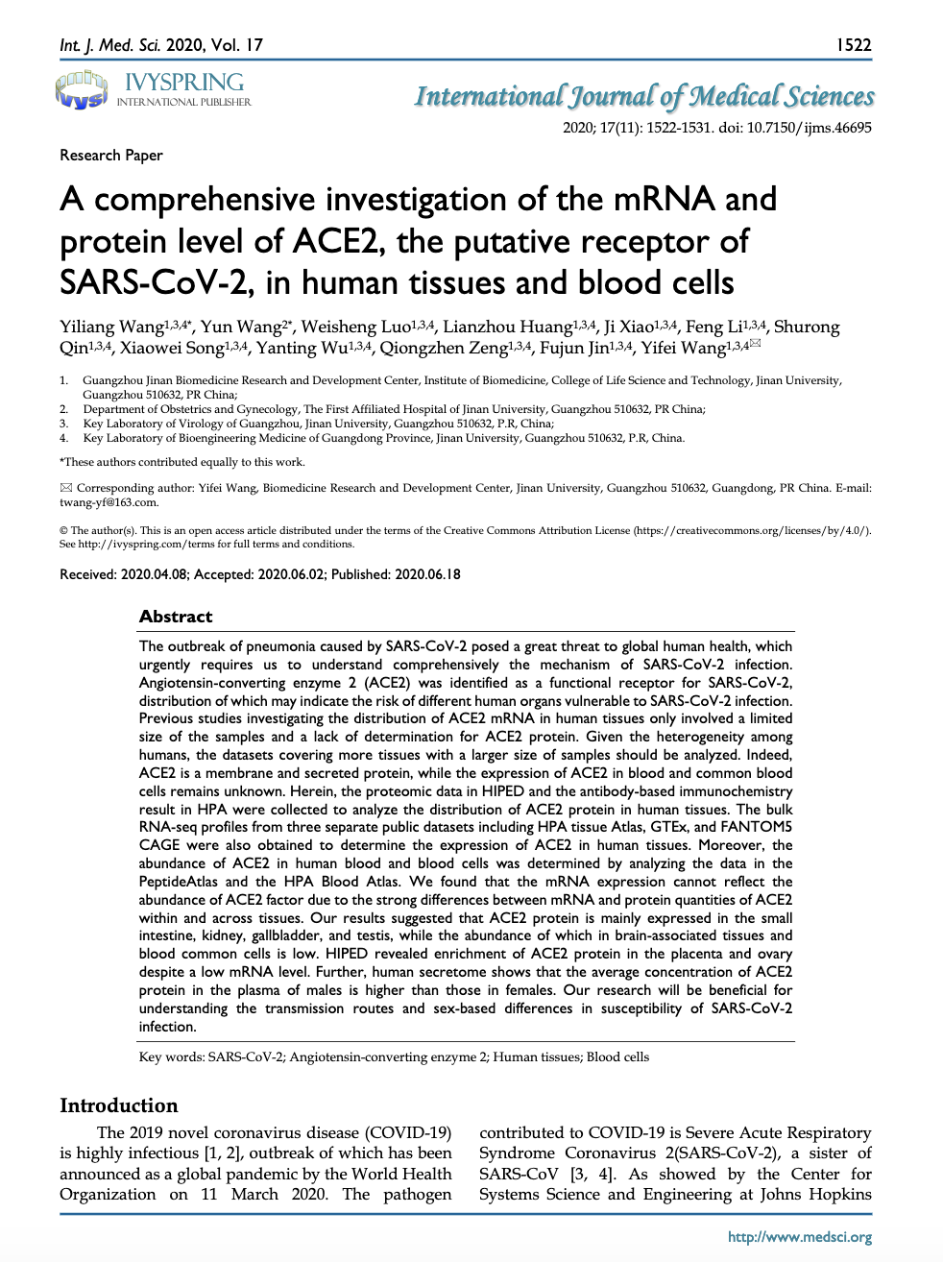
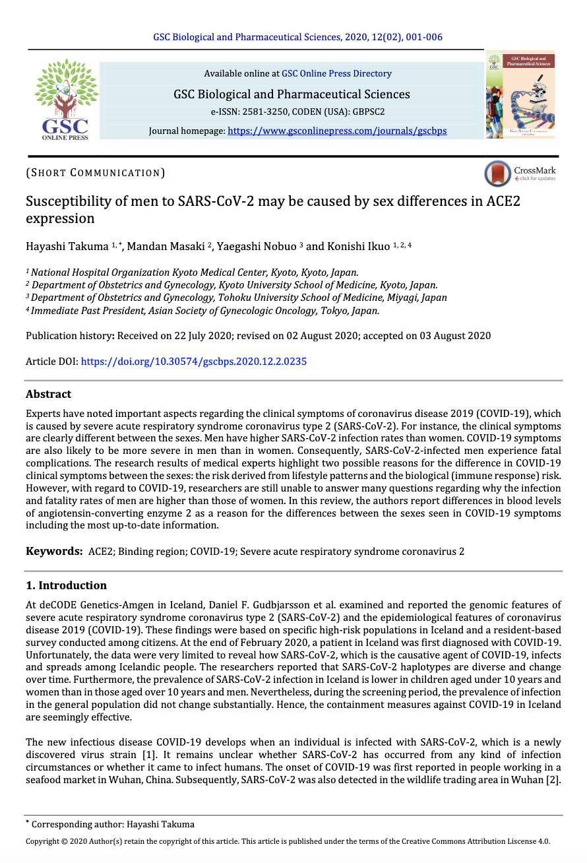
A growing list of COVID-19 publications using Olink
Proteomic Screen for COVID-19 needs

Slide 6
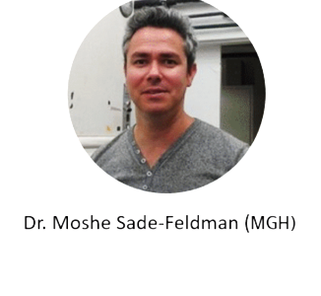
Proteomic Screen for COVID-19 needs
Started by Harvard, MIT, and Stanford, now joined by 30 universities, aiming to combine data from the most critically important technologies that may help prevent, diagnose, or treat COVID-19 infections, and to share the findings openly to accelerate research, inform the public health response and help save lives.
1st data publicly released : >1 million NPX from Olink Explore

Slide 7
Proteomic Screen for COVID-19 needs
Initial findings from largest COVID-19 protein study from MGH Collaboration
As of 9/2020, COVID19 has caused over 1,000,000 deaths globally
To date, the underlying disease mechanisms are poorly understood
Biomarkers are needed to predict disease severity and outcomes, stratify patients, guide therapy and drive drug/vaccine development
Using Olink Explore, we successfully predicted severity and outcome of COVID-19 infections in patients at the time of hospital admission
Day 0
Day 3
Day 7
384 patients
306 COVID+
78 COVID-
Detailed clinical annotations and evaluation of clinical outcome at day 28
Plasma
>1,400 plasma proteins by Proximity Extension Assay
Immuno Reaction
Extension
Detection by NGS
“We are grateful to have entered this collaborative effort with Olink to investigate the plasma proteomic signatures of COVID-19 patients and with Olink’s help have profiled over 1400 plasma proteins in our entire cohort.
We hope together we can provide the clinical and scientific community with a rich dataset for further investigation of pathways underlying severe disease that may be the basis for early diagnosis and clinical intervention.
As such, we are eager to share our data broadly with the scientific community to augment others’ findings and to accelerate discovery that may lead to new therapies and a better understanding of the underpinnings of COVID-19.”
Classification of patient phenotype using random forests and Lasso regression
Dr. Michael Filbin, M.D., M.S.
Department of Emergency Medicine, MGH, Boston
Unsupervised clustering and identification of patient phenotypes
Integrated analysis of proteomic signatures with scRNASeq
Linear mixed model for time and severity effects, as well as aging, neutralization and lymphophenia

Slide 8
Proteomic Screen for COVID-19 needs
Novel Proinflammatory Pathways Discovered
Little is known about immunological mechanisms underlying severity
Multiplex analysis of cytokines in plasma to assess the immune system and response of COVID-19 patients with mild-to-severe disease from two geographically distant cohorts.
Revealed enhanced levels of several proinflammatory cytokines and strong association of the inflammatory mediators EN-RAGE, TNFSF14, and OSM with the clinical severity of the disease.
These results reveal mechanisms and potential therapeutic targets for COVID-19.
Cytokine levels of healthy or COVID-19 infected individuals
As of 9/2020, COVID19 has caused over 1,000,000 deaths globally
To date, the underlying disease mechanisms are poorly understood
Biomarkers are needed to predict disease severity and outcomes, stratify patients, guide therapy and drive drug/vaccine development
Using Olink Explore, we successfully predicted severity and outcome of COVID-19 infections in patients at the time of hospital admission
Bali Pulendran, Professor of Pathology, Stanford University

Slide 9
Proteomic Screen for COVID-19 needs
Increasing our Understanding of COVID-19 Severity
Aimed to find biomarkers of COVID-19 pathophysiology to identify patients most at risk of developing severe lung inflammation
Identified important pathways involved in dysregulation of inflammation in patients with severe COVID-19
These findings indicate predictors of patient outcome and identify targets for potential immunotherapy treatment.
Proteins assessing COVID-19 disease severity
As of 9/2020, COVID19 has caused over 1,000,000 deaths globally
To date, the underlying disease mechanisms are poorly understood
Biomarkers are needed to predict disease severity and outcomes, stratify patients, guide therapy and drive drug/vaccine development
Using Olink Explore, we successfully predicted severity and outcome of COVID-19 infections in patients at the time of hospital admission
Non-ICU patients
ICU
patients
Identified several differences in patients that require intensive care, e.g. IL-6, several chemokines and hepatocyte growth factor
Stem cell factor and inhibitors of the kinin-kallikrein pathway were downregulated which may represent important therapeutic target in severe COVID-19 with acute respiratory distress syndrome
Leo Joosten, Professor of Mechanisms of Inflammatory Disease at Radboudumc
“This is a very robust systems – it works across plasma, serum and supernatant”

Slide 10
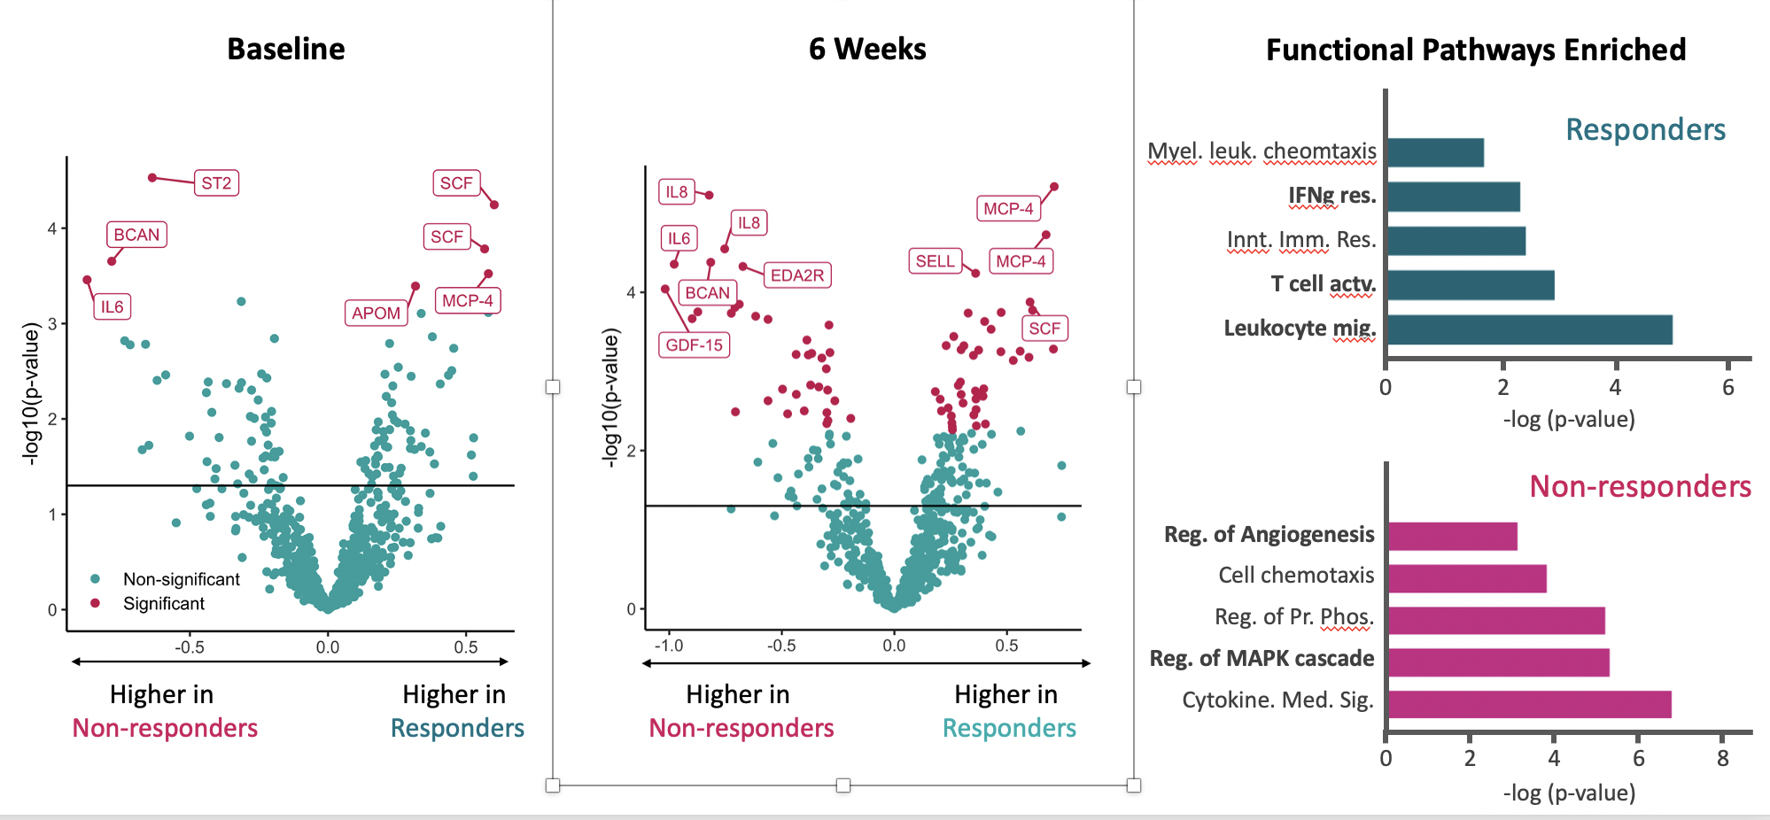
Proteomic Screen for COVID-19 needs
Olink Captures Response Signatures and Therapeutic Impacts on Biology
Predictive Biomarker Signatures
Response biomarkers to therapy
Mode of action biomarkers
In vitro study of downstream effects of therapy (Otezla®)
Identification of pharmacodynamic biomarkers
Findings hold promise for repositioning of the drug to other disease areas
Phase 3 study (APOLLO) with patients receiving placebo or drug (patisiran)
Significant change in 66 proteins in drug (Patisiran) vs. placebo
The proteome of patients treated trended towards healthy individuals at 18 months

Slide 11
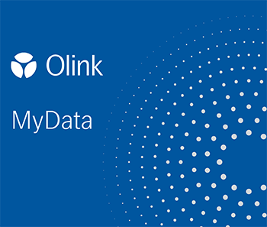
Proximity Extension Assay
Proteomic Screen for COVID-19 needs
Olink Product Portfolio
Explore
COVID-19 samples
Immuno Reaction
Extension Reaction
Measure 1,536 proteins,
Soon 3k and 4,5k proteins covering the dynamic plasma proteome.
Target 384
Small volume and
matrix flexibility
High sensitivity with
no cross-reactivity
Analog to digital converter
1µl and outstanding coverage of inflammatory cytokines
Target 96
15 panels built for specific area of disease or biology process.
Detection
QC & Data analysis
Proteomic Profiling
Target 48
48-plex Cytokine panel with absolute quantification.
Focus
Measure up to 21 proteins simultaneously, selected based on your discoveries and needs
High multiplexing
and throughput
Robust and reproducible
data to trust
Actionable results driving your research forward

Slide 12
Conclusion
With plasma proteomics, we can rapidly paint a comprehensive picture of how your therapeutic/vaccine strategy impacts multiple organ systems
We provide the broadest high-quality coverage of inflammatory proteins driving cytokine storms
We are the trusted provider to the COVID Technology Access Framework from the largest proteomics COVID project in the world
Let us help with the analysis of your COVID-19 samples by offering
Inactivation of SARS-CoV-2 infected samples
Short turnaround time of sample analysis (4-6 weeks)
Access to results from largest proteomics dataset from extensive COVID-19 cohort
Where do you see Olink having the biggest potential impact on your COVID efforts?

Slide 13
Reactions to open-access data
“Thank you for making these data available to the research community.”
“We are doing a network-based analysis of the viral infection and it would be very interesting at looking at protein levels using the information provided here”
“Very much appreciate your free access data initiative. Hope the research community becomes open like this for the benefit of humanity even after the present pandemic completely resolves.”
“I am working on multi-omics of population health. This data will be really useful for the science society. Thanks a lot for your contribution.”
“Thanks for this initiative! This is amazing.”
“I am very much interested by the technology, and by COVID pathology”
“We would like to utilise these tremendous resources to identify key biomarkers that associate with various health conditions.”
“This is quite an impactful program.”
“We would be interested to use Olink explore to monitor the therapeutic efficacy.”
“Working on COVID and potentially using OLINK platform and am interested in results”
“Thank you for this MGH-Olink resource which can be instrumental in our efforts to understand and eradicate COVID-19.”
“Interested in large scale study using Olink platform”
“We are expert on Systems Immunology, and we have transcriptome data of COVID-19 patients. It would be really nice integrating this data with the Olink data.”
“Thank you for sharing this tremendous resource with the scientific community.”
“Accessing the protein profile linked with clinical data of patients is a valuable tool to identify possible therapeutic targets to treat COVID19.”
“This is very interesting dataset to explore and relevant to understand protein expression during COVID19 infection and clearance. Thanks for sharing.”
Notes:
Olink 1.5k
Drug Targets 356
KlinKem 76
Blood Atlas 306
Organ Specific 125
Inflammation 562
Alkahest 672
Exploratory 236

